Slide 1
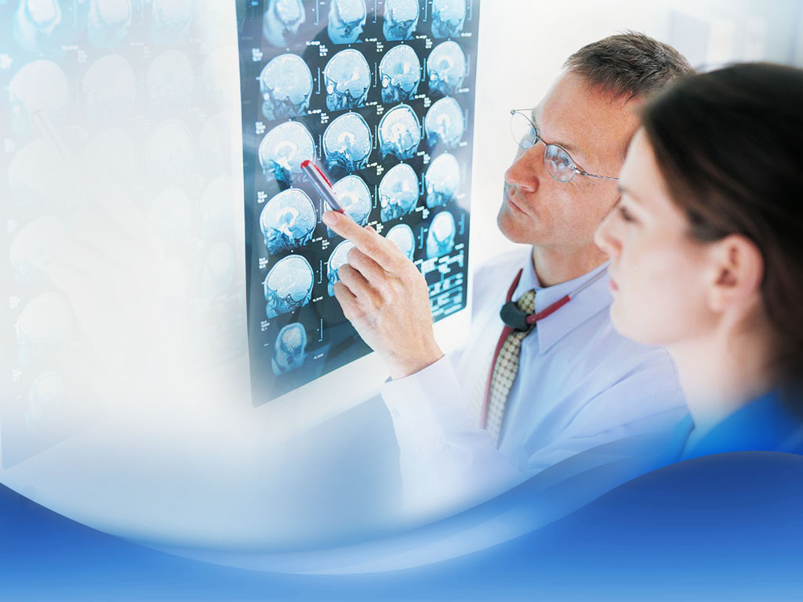

Anomaly Alzheimer Detection in MRI
Team 6
Wang Ruipeng
Wang Shengming
Wang Yuyan
Huang Jing
Yueyang Jiang

Slide 2
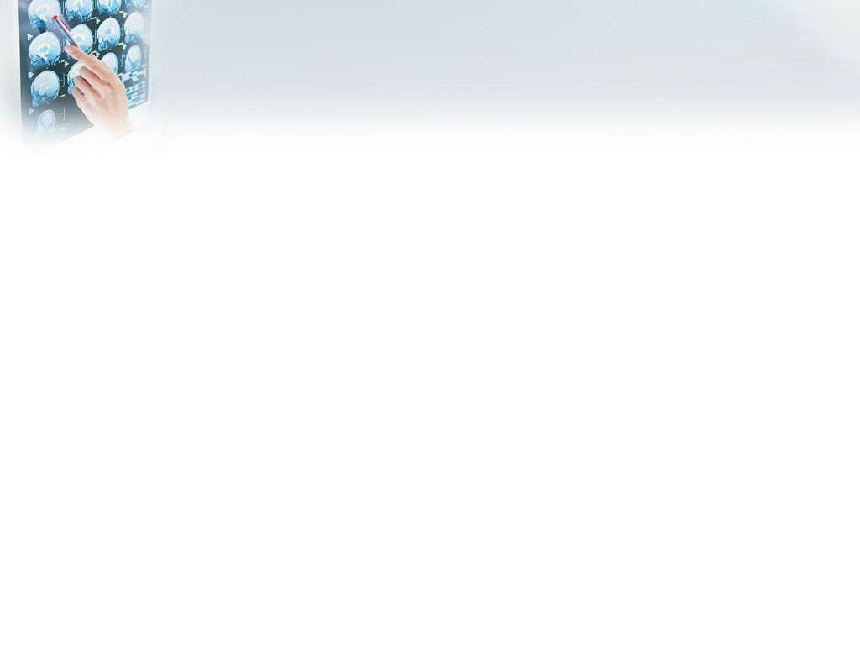
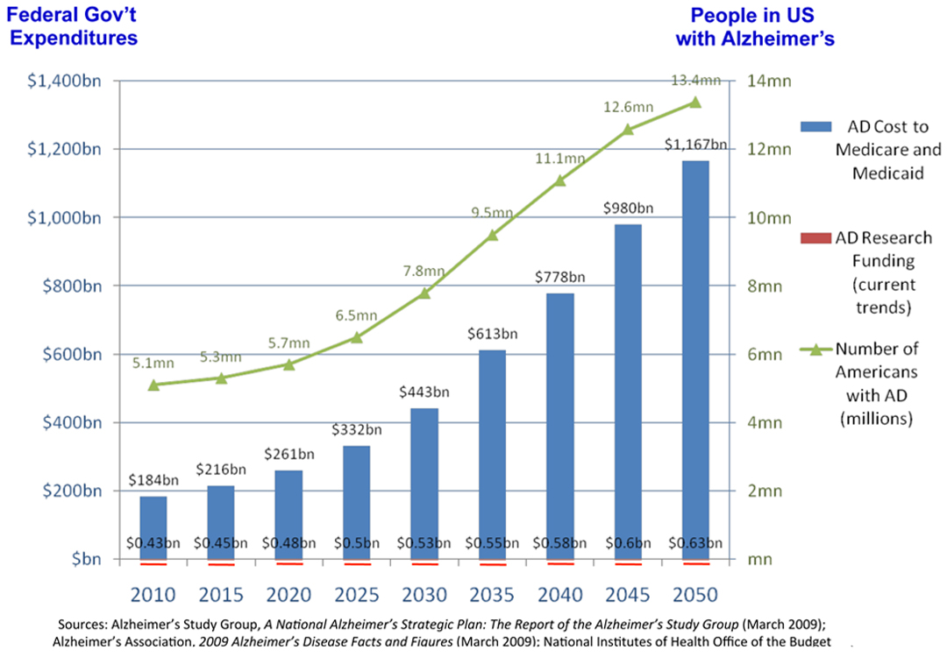
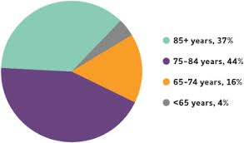
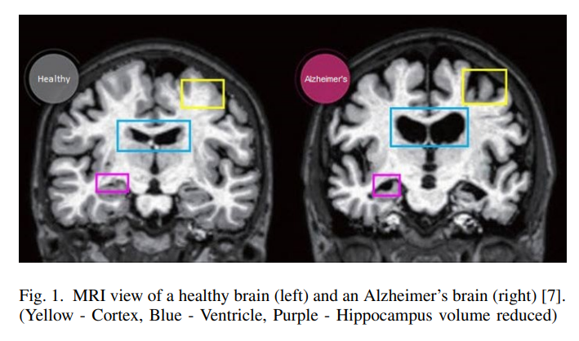
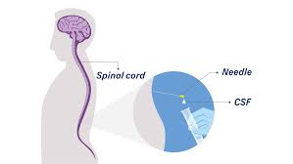
Background and Introduction

Slide 3
Background and Introduction
Huge financial burden for individual and government
diagnostic accuracy varies
Biomarker is expensive and controversial
Long course of disease
Improve diagnostic rate
Machine learning classification tool
Cheaper and non-invasive
Faster with less resources

Slide 4



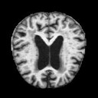
Problem Formulation
Based on the diagnosis according to the MRI images, models are built to classify the stage of Alzheimer's disease and detect the brain abnormality of patients.
Diagnosis(Y):
Non-Demented
Moderate Demented
Mild Demented
Very Mild Demented
MRI images
(X)
Models

Slide 5

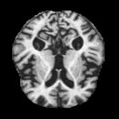
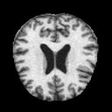
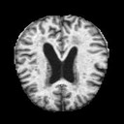
Dataset Information
6,400 images
128 x 128 pixels
3,200 Non-demented /3,200 Demented
(50% / 50%)
Mild Demented (896 images)
Moderate Demented (64 images)
Stratified sampling with
80:10:10 Train-Test-Validation ratio
Non-Demented (3200 images)
Very Mild Demented (2240 images)

Slide 6
Overall ratio is (train: test: validation=0.8:0.1:0.1)
Different data distribution of 4 classes? How to evaluate?
Type | Train | Test | Validation
Non-Demented | 2560 (50%) | 320 (50%) | 320 (50%)
Very Mild | 1792 (35%) | 224 (35%) | 224 (35%)
Mild | 716 (13.98%) | 90 (14.06%) | 90 (14.06%)
Moderate | 52 (1.02%) | 6 (0.94%) | 6 (0.94%)

Slide 7
Overall ratio is (train: test: validation=0.8:0.1:0.1)
Different data distribution of 4 classes? How to evaluate?

Slide 8
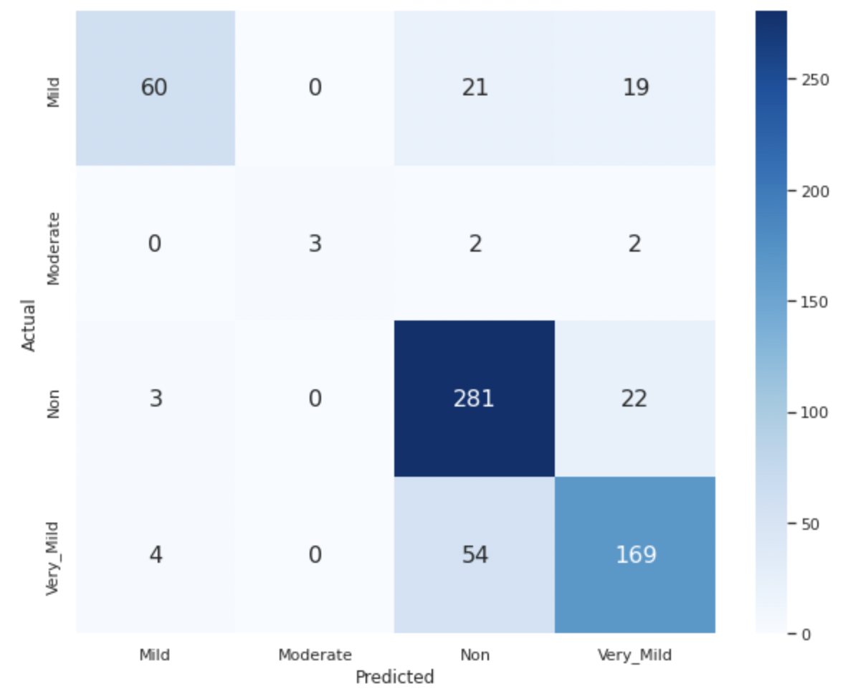
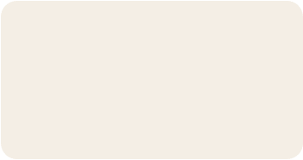
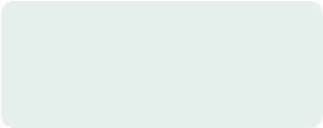
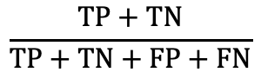
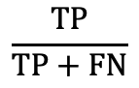
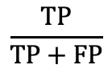
Performance Measures
Accuracy
Recall
$$\frac{TP+TN}{TP+TN+FP+FN}$$
$$\frac{TP}{TP+FN}$$
Confusion Matrix
Precision
$$\frac{TP}{TP+FP}$$

Slide 9


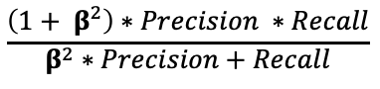
Performance Measures
In this case, it is critical that our models minimize inaccurate predictions that a person is diagnosed with no Alzheimer's, but he/she actually has (False Negative).
Therefore, we emphasize more on Recall than Precision.
Minimize False Negative
F2 Score
Set β = 2 to give more weights on recall

Slide 10
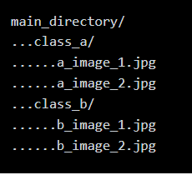
Image Preprocessing
Python Imaging Library (PIL)
Image.open to read images and convert to pixel lists
normalize the values to range from 0 to 1
Keras Image data preprocessing
Generates a tf.data.Dataset that yields batches of images from the subdirectories class_a and class_b, together with labels 0 and 1 (0 corresponding to class_a and 1 corresponding to class_b).

Slide 11








Approach
Image Classification
Naïve Bayes Classifier
Logistic Regression
Random Forest
Artificial Neural Network
Deep Learning
Convolutional Neural Network
Convolutional Recurrent Neural Network
Tools

Slide 12
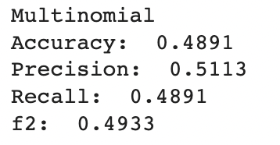
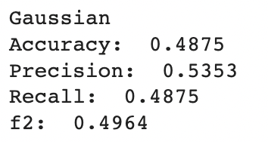
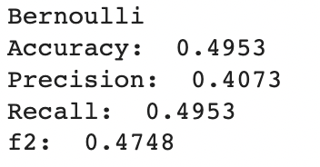

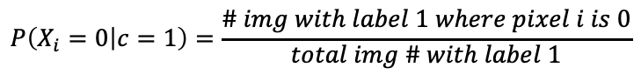
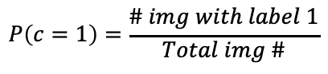
Naïve Bayes
C
{0, 1, 2, 3}
X₁
X₂
X_{16,384}
Multinomial
Gaussian
Bernoulli
[0, 1]
$$P\left(c=1\right)=\frac{\# img with label 1}{Total img \#}$$
$$P\left(X_{i}=0 | c=1\right)=\frac{\# img with label 1 where pixel i is 0}{total img \# with label 1}$$
$$Predict label I for which P(c=I|X_{1}…X_{16,384})$$
Results

Slide 13

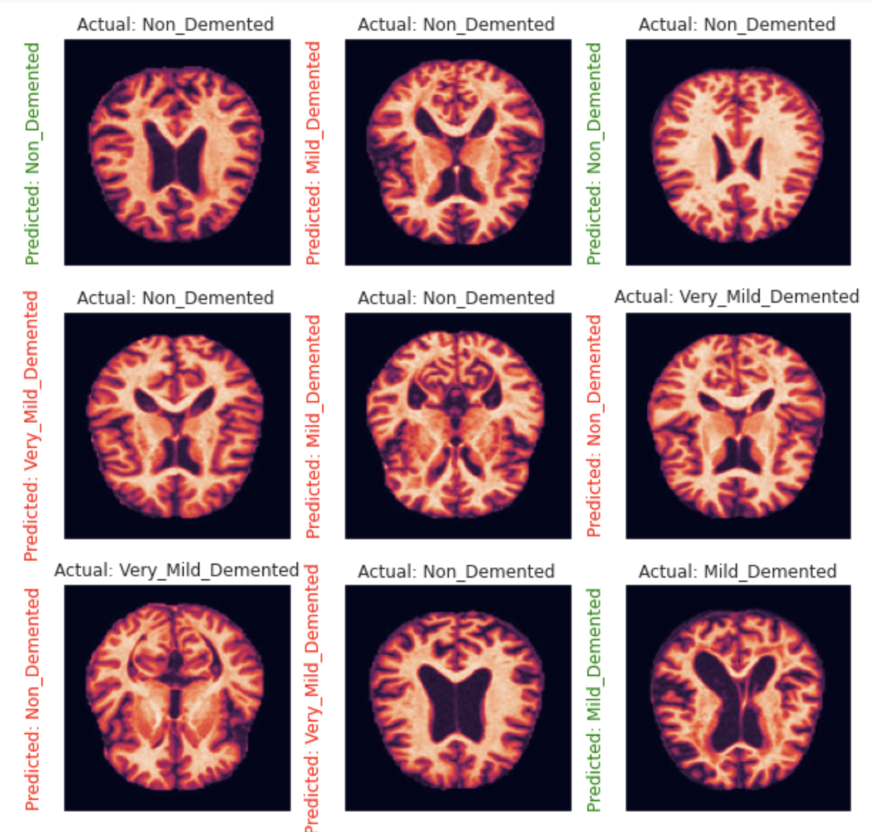
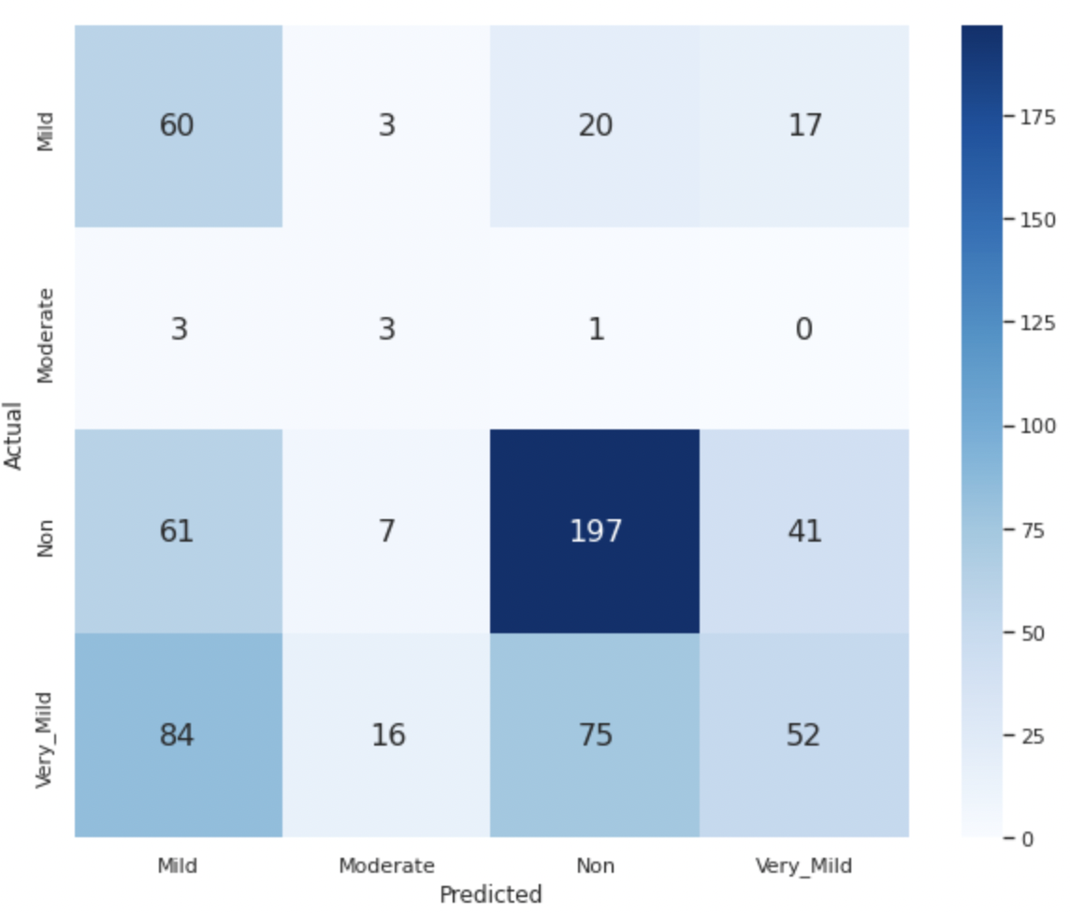
Gaussian Result

Slide 14
Logistic Regression
Parameters:
Penalty = none
Tol = 0.1
Multi_class = multinomial
Solver = saga
Result:
Accuracy: 80.16%
Precision: 80.89%
Recall: 80.16%
F2: 80.30%

Slide 15

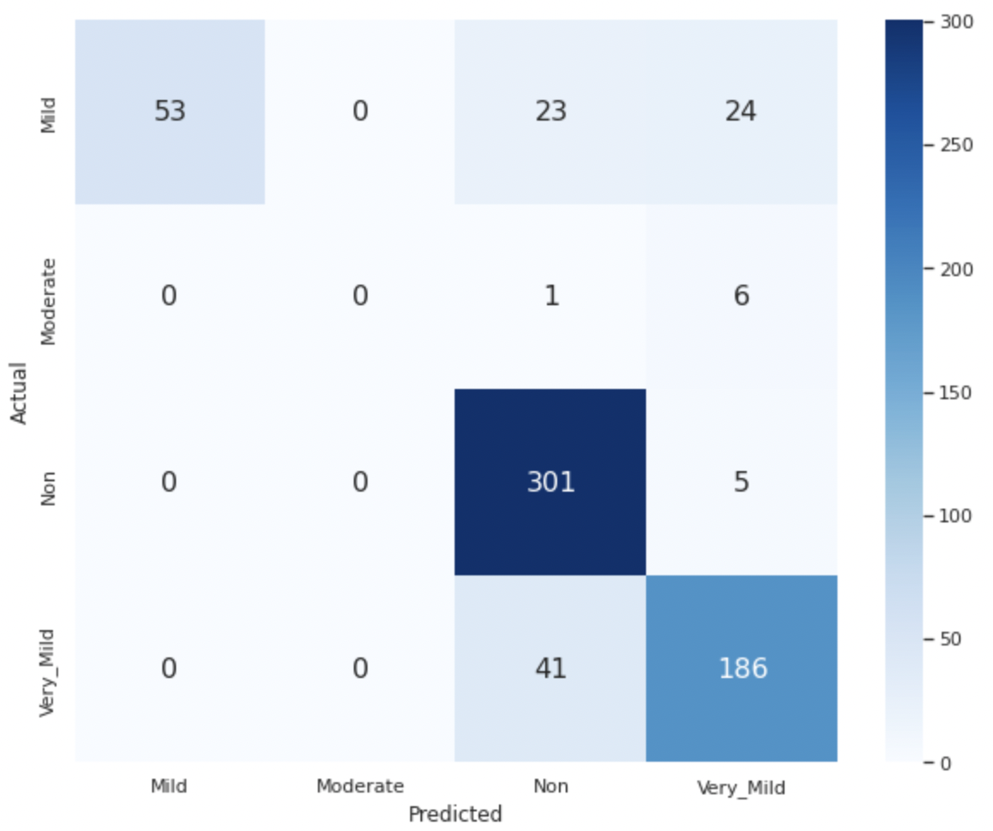
Random Forest
Parameter:
Min sample split = 3
Max depth = 9
Max features = sqrt
Result:
Accuracy: 84.38%
Precision: 84.80%
Recall: 84.38%
F2: 84.46%

Slide 16
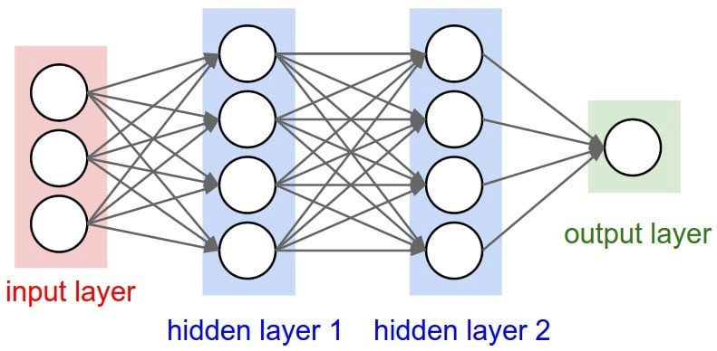
ANN Architecture
128
64
128x128x3
4
softmax
relu
relu
Optimizer | Loss | Metrics
Adam | Sparse categorical cross entropy | Accuracy

Slide 17
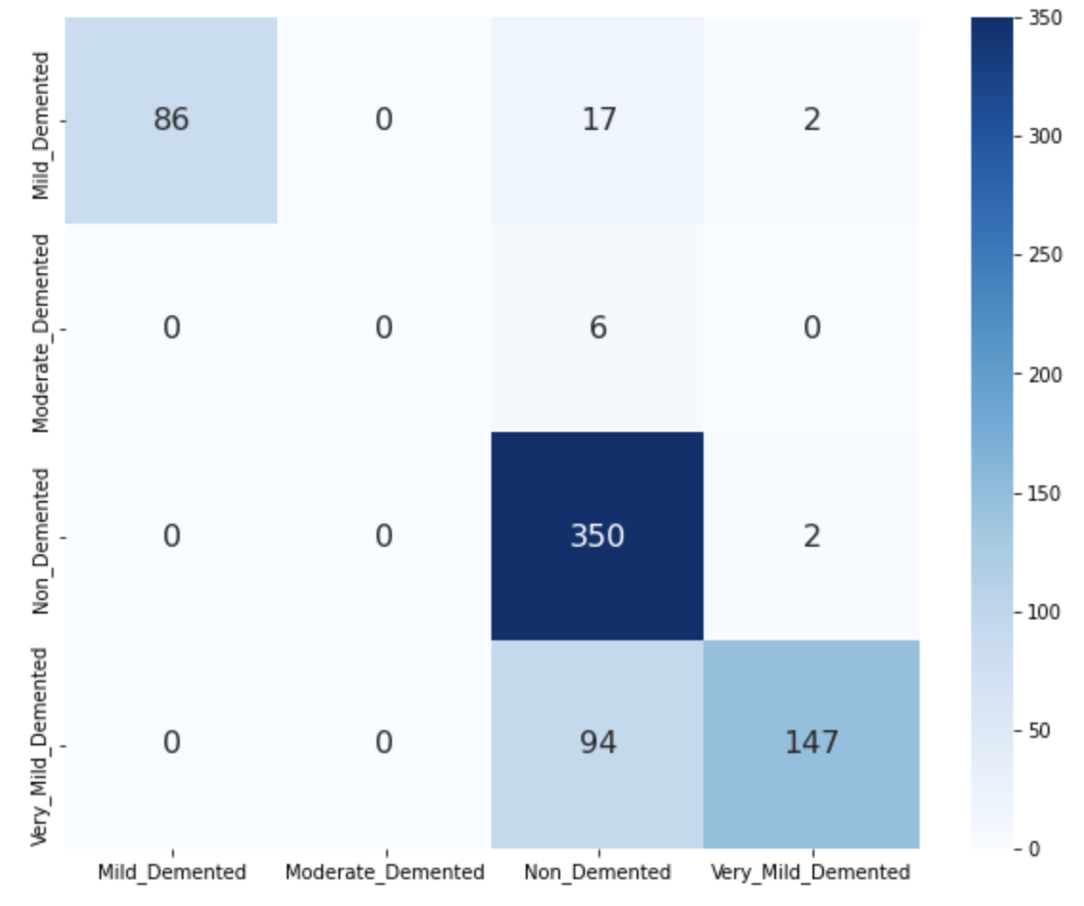
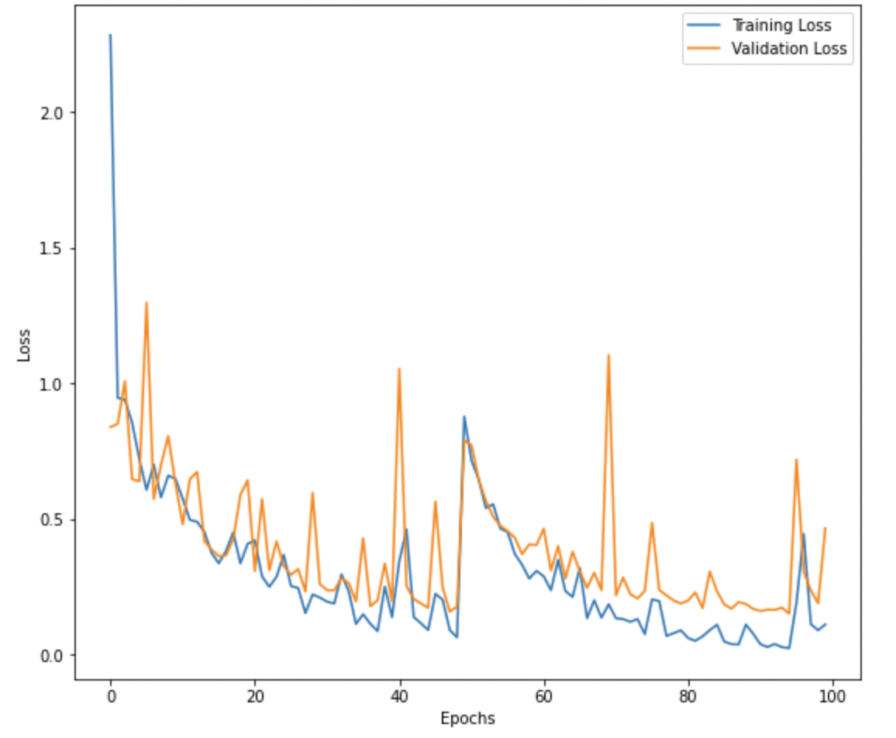
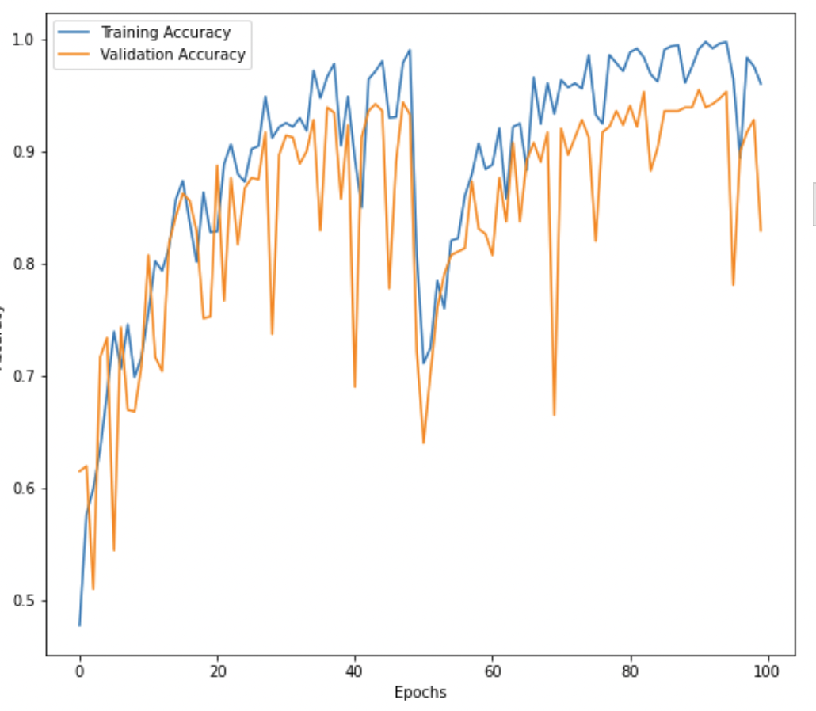
ANN Result
Epochs: 100
Accuracy: 81.7%
F2: 61.06%
Confusion Matrix

Slide 18
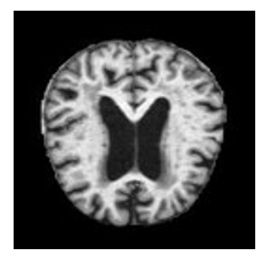

CNN Architecture
keras.layers.Conv2D
16 filters
padding
3x3 kernels
he_normal
32 filters
padding
3x3 kernels
he_normal
64 filters
padding
3x3 kernels
he_normal
Input
Output
Conv2D
+ Relu
Conv2D
+ Relu
Conv2D
+ Relu
Softmax
Pooling
Pooling
4 classes
Dropout
Dropout
Conv2D: 2D images
Max pooling
Random Dropout
Filter: the number of output filters in the convolution
Padding: 'same' -> zeros evenly to the left/right or up/down of the input
Kernel_size: height x width of the 2D convolution window
He_normal: initialize weights -> samples from a truncated normal distribution centered on 0

Slide 19

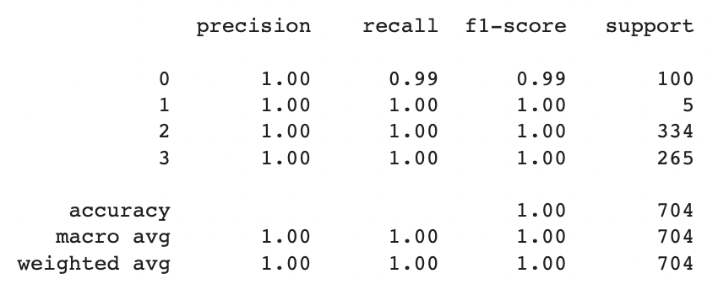
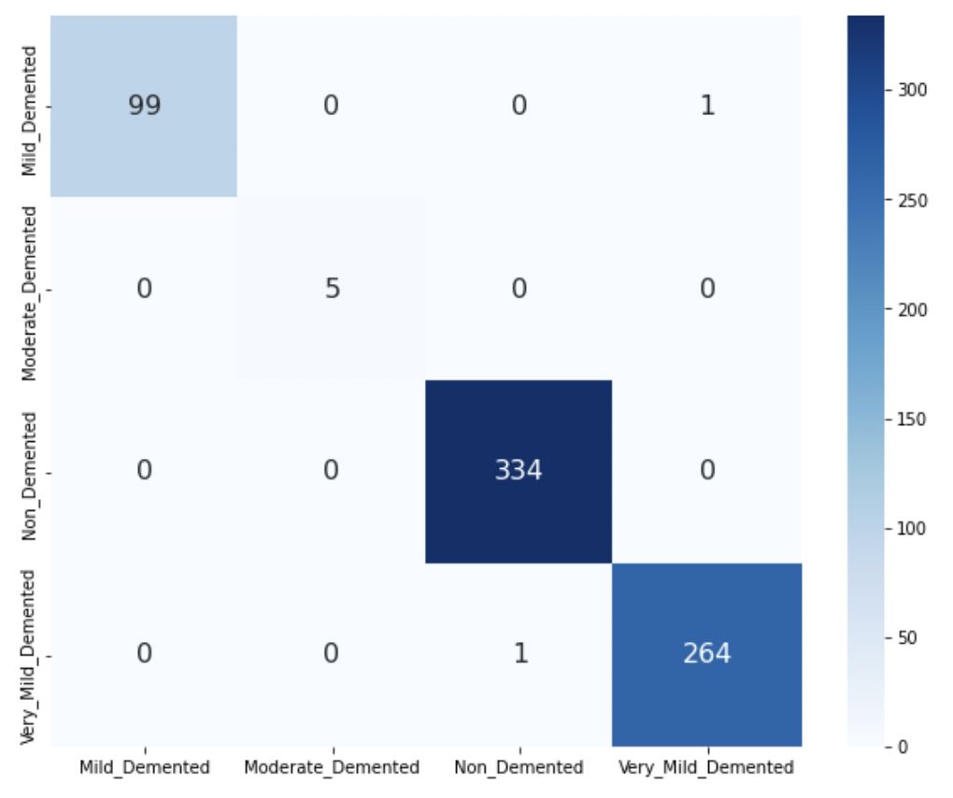
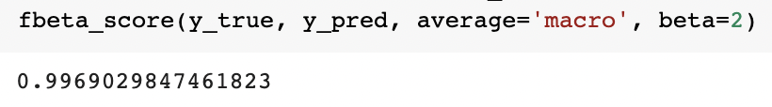
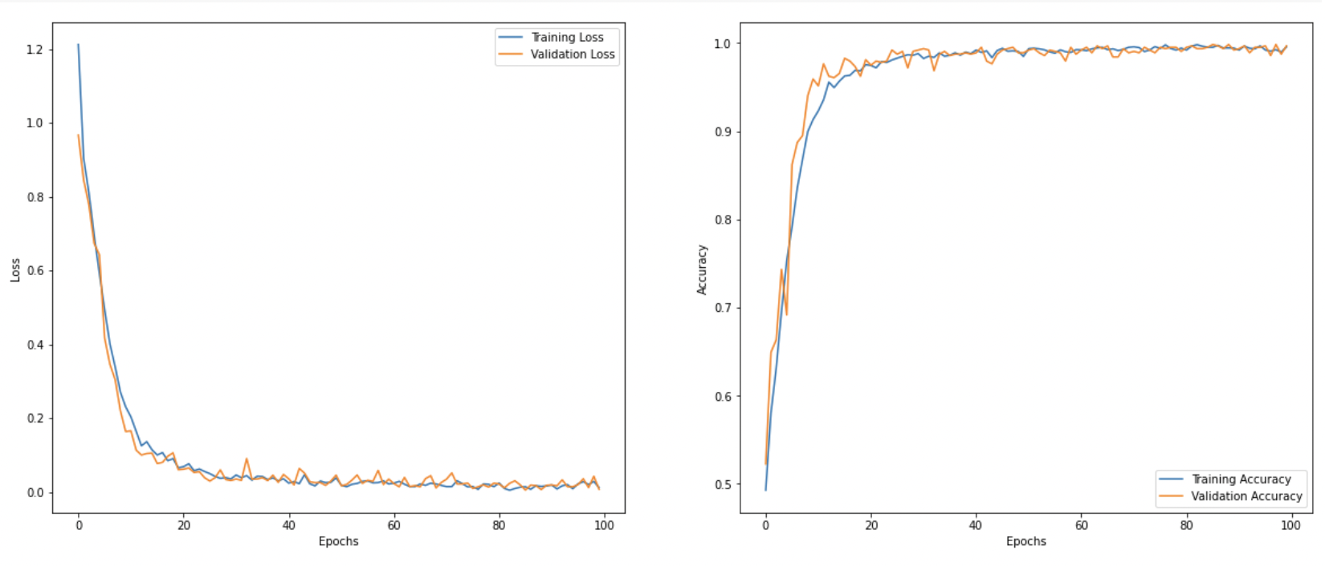
CNN Result
Classification Report
F2 Recall

Slide 20
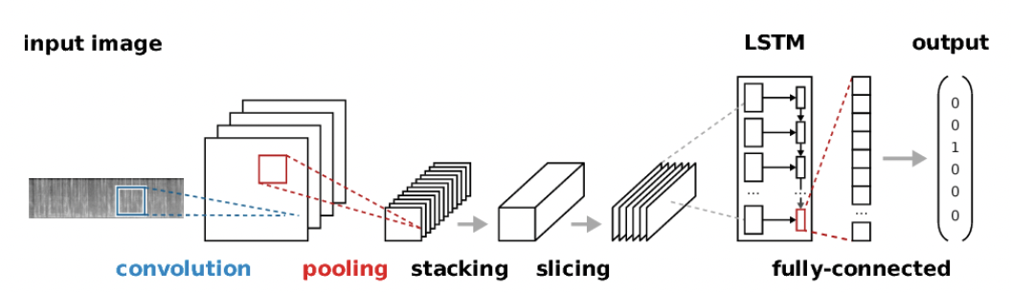
CRNN Architecture
Input
Output
Conv2D
+
Relu
Recu
+
Relu
Tran
+
Relu
Softmax
Dropout
Dropout
4 classes
Convolutional Layer : Extracts features through CNN Layer.
Recurrent Layer : Splits the features into a certain size and inserts them into the input of the Bidirectional LSTM or GRU.
Transcription Layer :Conversion of Feature-specific predictions to Label using CTC (Connectionist Temporal Classification).

Slide 21
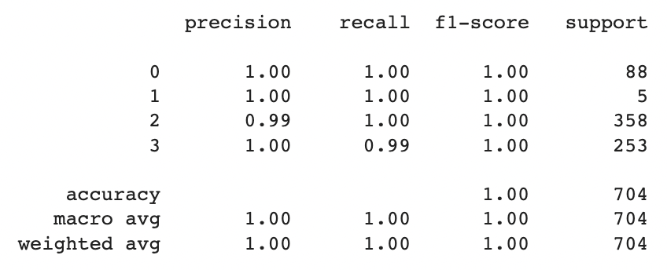
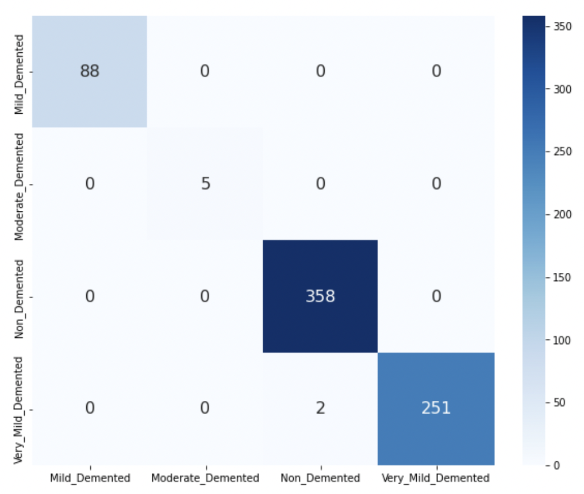
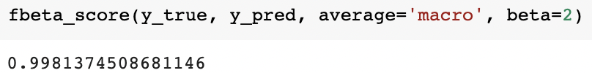
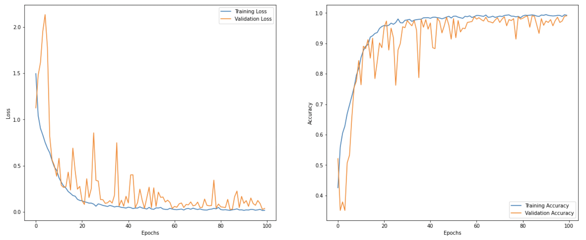
CRNN Result
Classification Report
F2 Recall

Slide 22
Summary
Deep Learning model has better performance
- CRNN > CNN > ANN
Accuracy nearly perfect / Recall around 99%
Better than Expert Diagnosis (75% accuracy)
- Let Machine Learning Model Shine !

Slide 23
Q & A Thank You !

Slide 24
References
Alzheimer's Association. "2018 Alzheimer's disease facts and figures." Alzheimer's & Dementia 14.3 (2018): 367-429.
Gunawardena, K. A. N. N. P., Rajapakse, R. N., & Kodikara, N. D. (2017, November). Applying convolutional neural networks for pre-detection of alzheimer's disease from structural MRI data. In 2017 24th International Conference on Mechatronics and Machine Vision in Practice (M2VIP) (pp. 1-7). IEEE.

